Slide 1
Generating Lambda Term Individuals
in Typed Genetic Programming
Using Forgetful A*
Tomáš Křen, Roman Neruda
Charles University, Faculty of Mathematics and Physics &
Institute of Computer Science, Academy of Sciences of the Czech Republic

Slide 2
Presentation outline
Standard population generating vs..
Exhaustive enumeration
Less exhaustive (more random) enumeration
Generalization for simply typed lambda calculus
Experiments

Slide 3
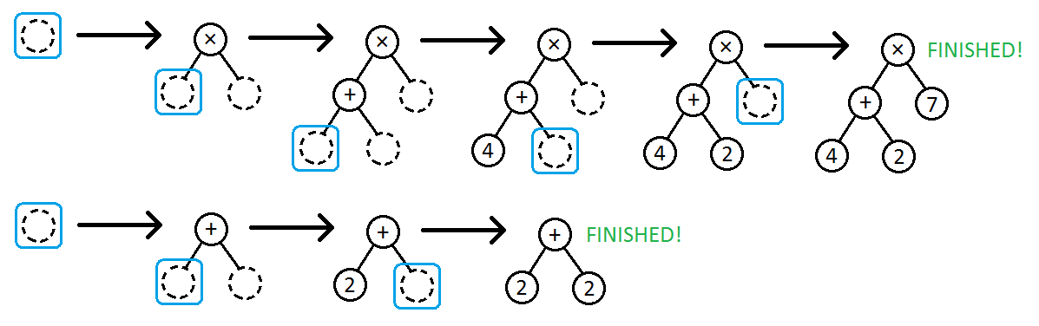
Standard generating procedure
works in separate iterations
  In each iteration one tree individual is generated.
We can do this differently:
  “Generating of shared parts can be shared.”

Slide 4
Exhaustive enumeration
Systematic population generating
  From smallest to biggest tree
We use A* algorithm
Let's see an example

Slide 5
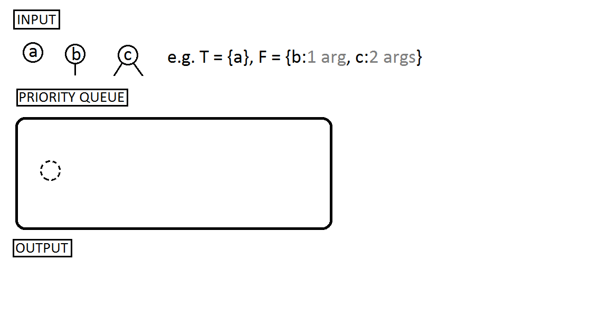
Exhaustive enumeration

Slide 6
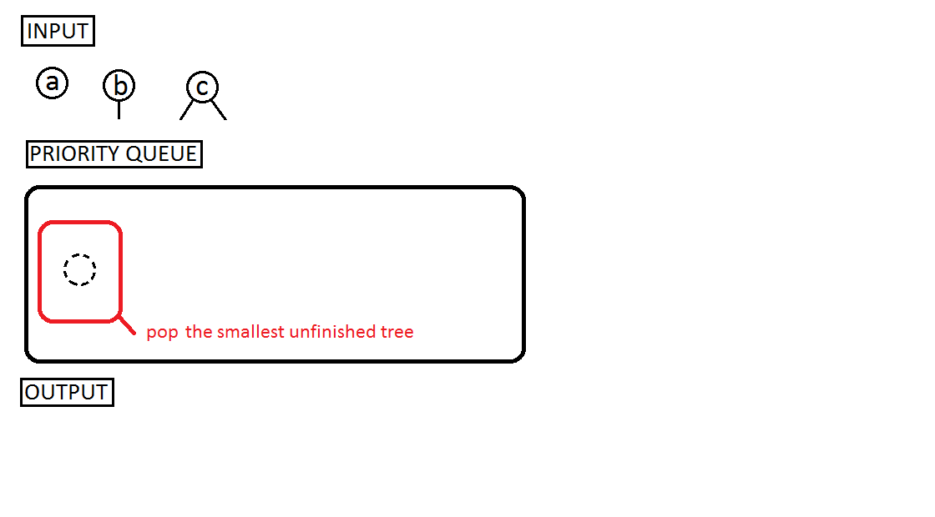
Exhaustive enumeration

Slide 7
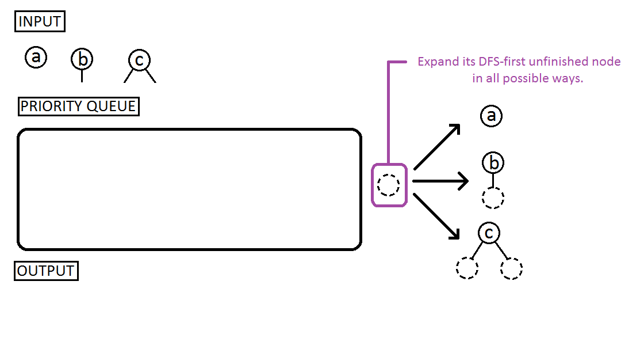
Exhaustive enumeration

Slide 8
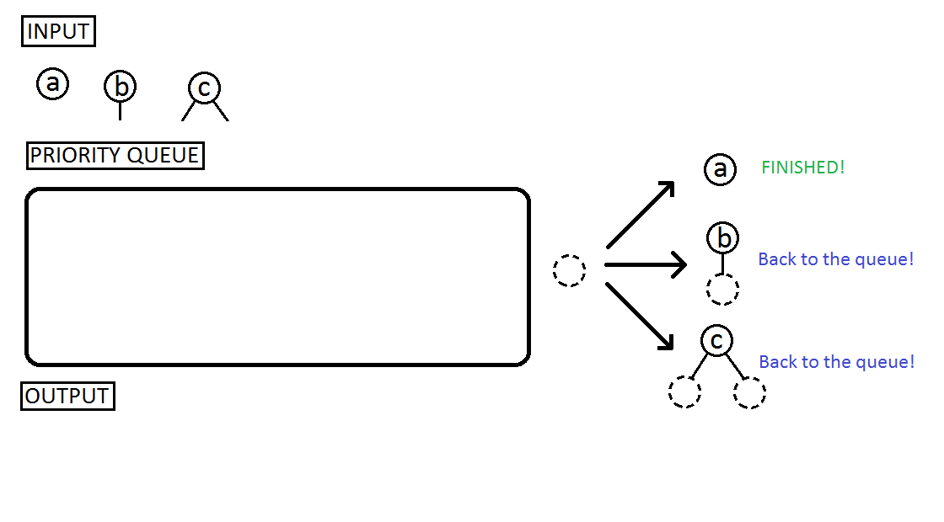
Exhaustive enumeration

Slide 9
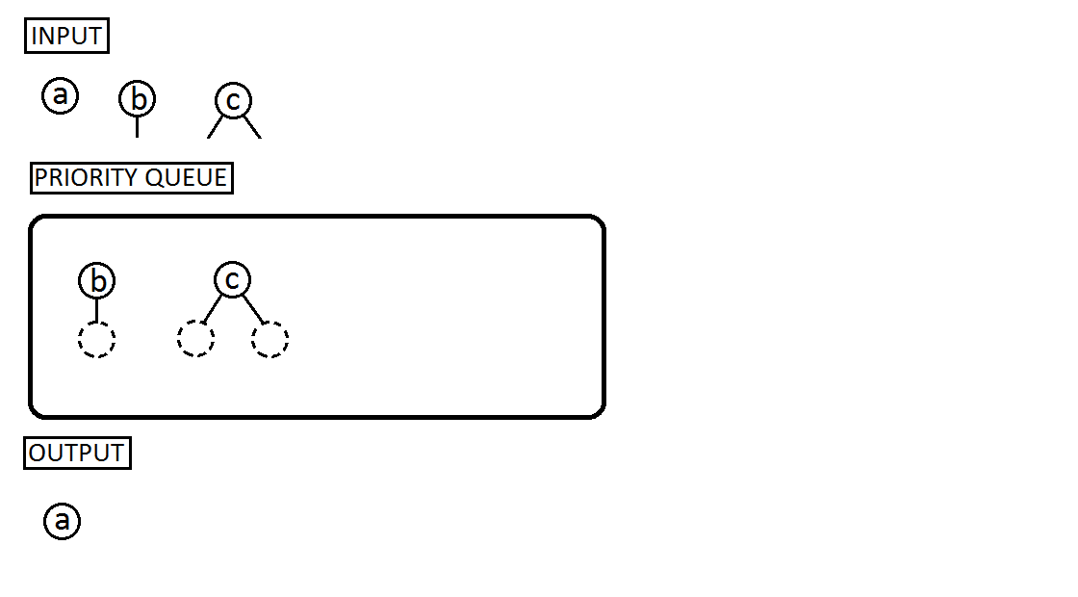
Exhaustive enumeration

Slide 10
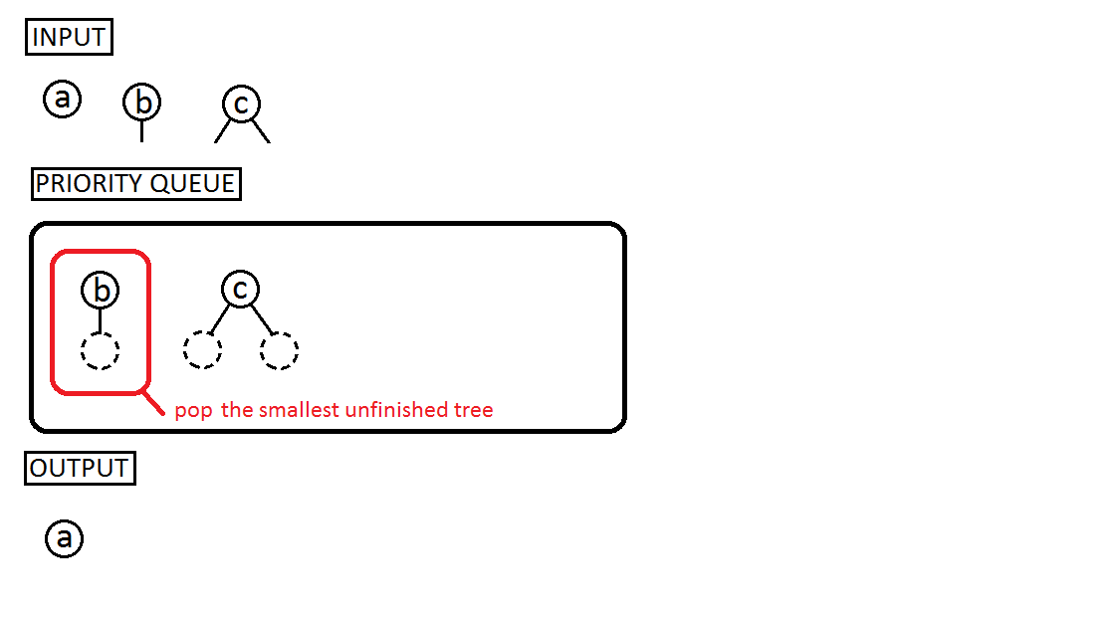
Exhaustive enumeration

Slide 11
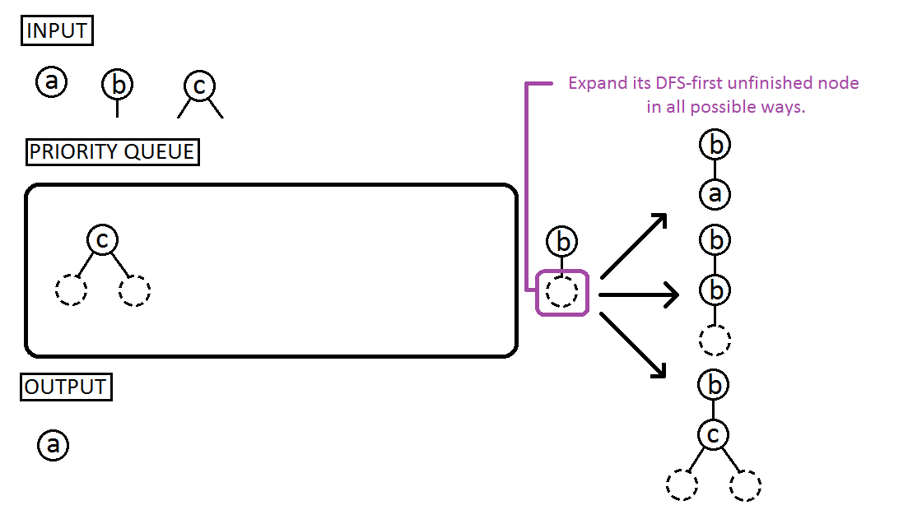
Exhaustive enumeration

Slide 12
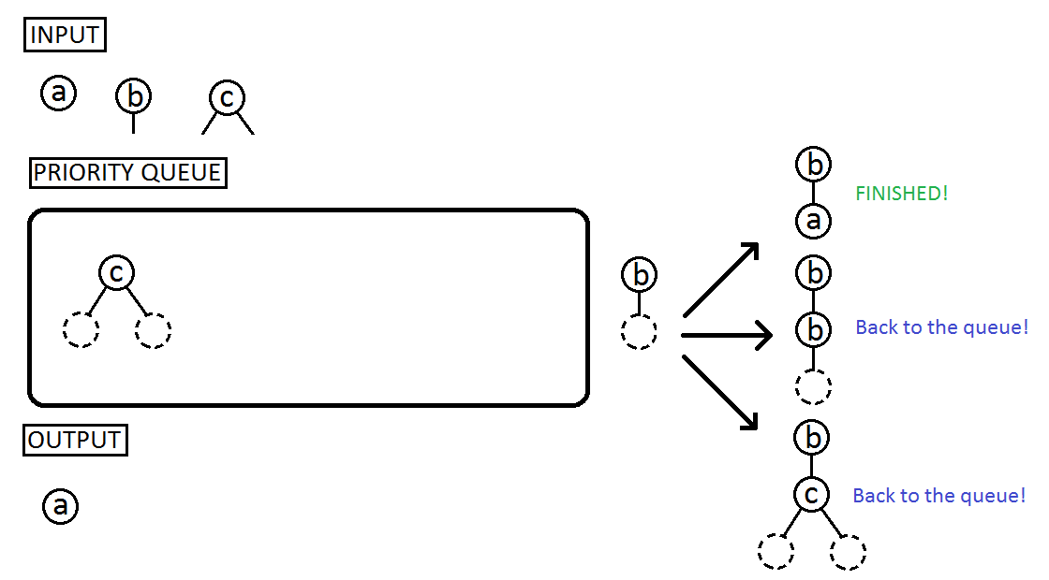
Exhaustive enumeration

Slide 13
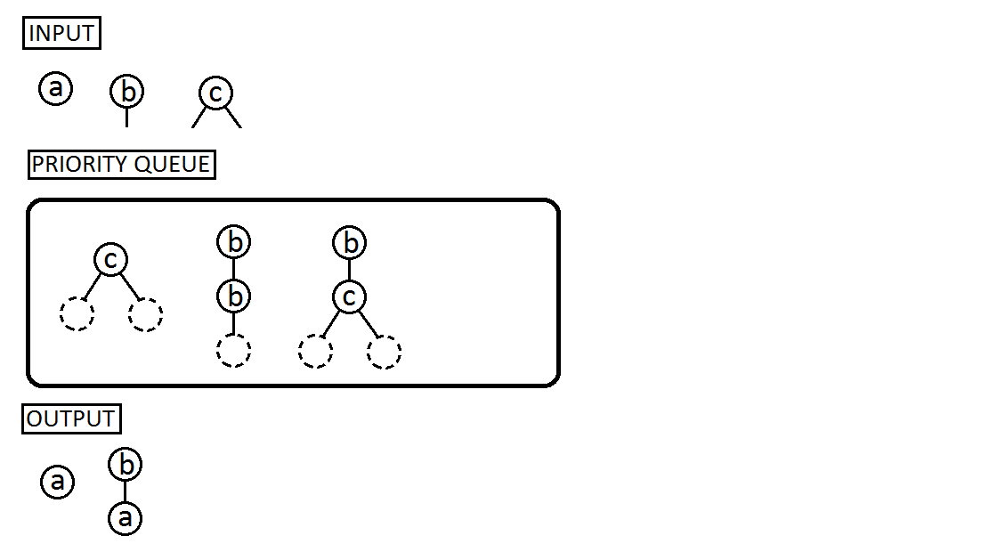
Exhaustive enumeration

Slide 14
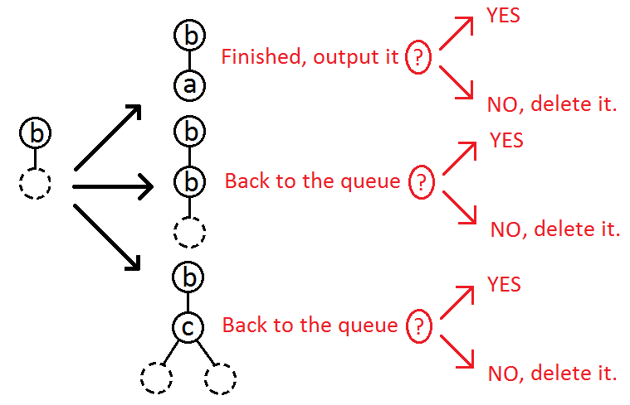
How to make enumeration more random?
We add a new step deciding what to do with an expanded tree:
  keep it,
  or delete it?
We call this additional decision procedure a generating strategy.
  “Keep all” strategy = exhaustive enumeration
  “Delete all but one” strategy = standard generating approach

Slide 15
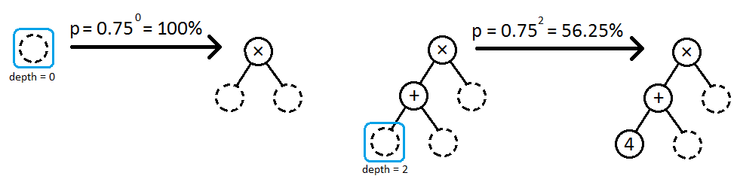
Our geometric strategy
It puts an expanded tree back to the queue with probability p = q^{depth}
Where q is a constant, we used q = 0.75
And depth is depth of the expanded node

Slide 16
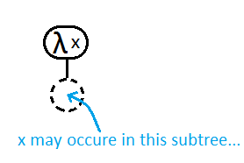
Lambda calculus
Simple yet powerful (mathematical) programming language
It uses anonymous functions very often.
  ( λ x . <function body, where x may occur> )

Slide 17
Types
Types help us overcome the closure requirement.
But also make the programs more reasonable.
(Local) context (usually denoted as Γ)
  Set of symbol names accompanied with types
  “T ∪ F is an initial/global context”
  We can add local variables to a context

Slide 18
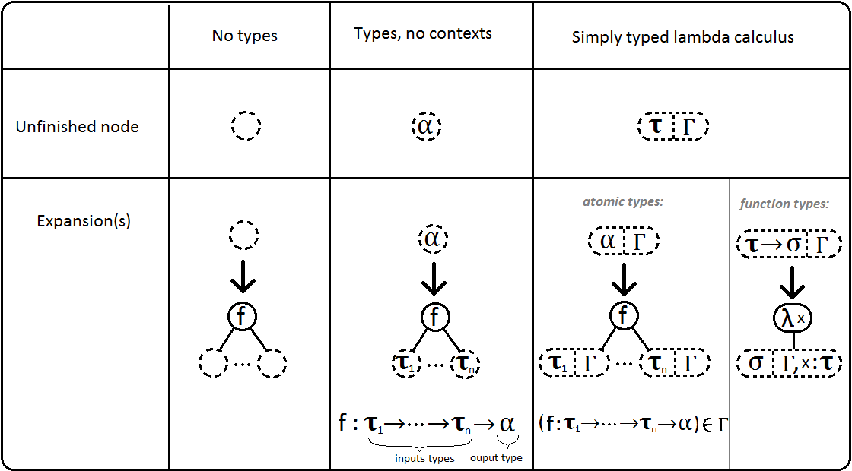
Generalization for simply typed lambda calculus

Slide 19
Experiments
We compared performance of our geometric strategy with standard ramped half-and-half on 3 benchmark problems.
50 runs, 500 population size, 51 generations
Metrics
  Average fitness of the best individual
  Average term size
  Cumulative probability of success
  Number of individuals that must be processed to yield a correct solution with probability 99%
  Time

Slide 20
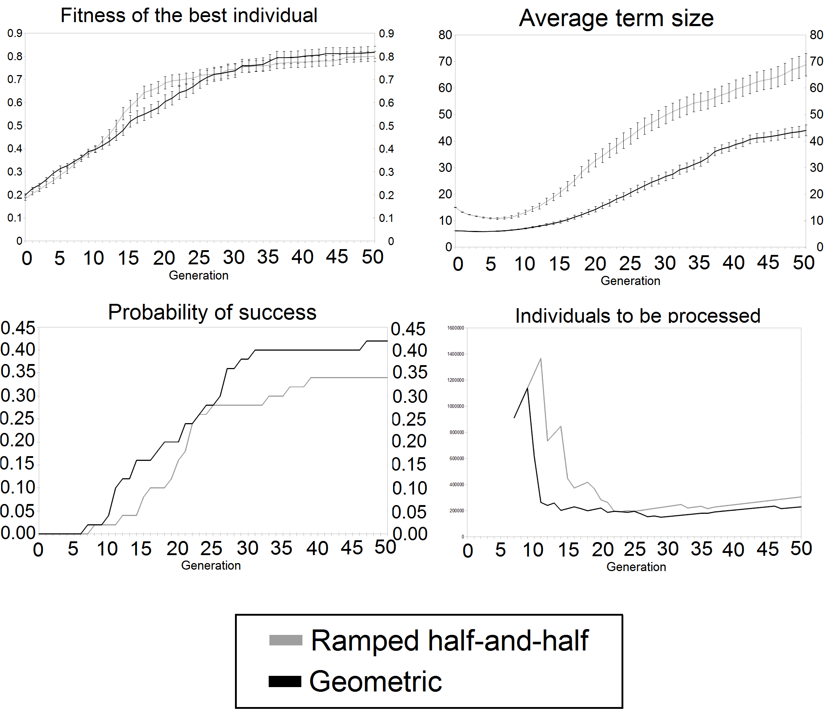
Simple symbolic regression
Times: 46 minutes
26 minutes

Slide 21
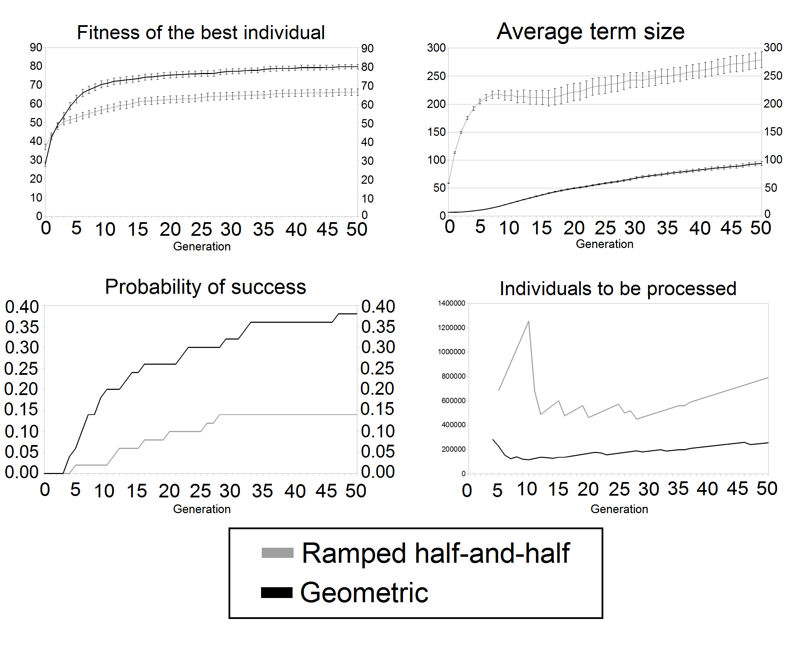
Artificial ant problem
Times: 265 minutes
107 minutes

Slide 22
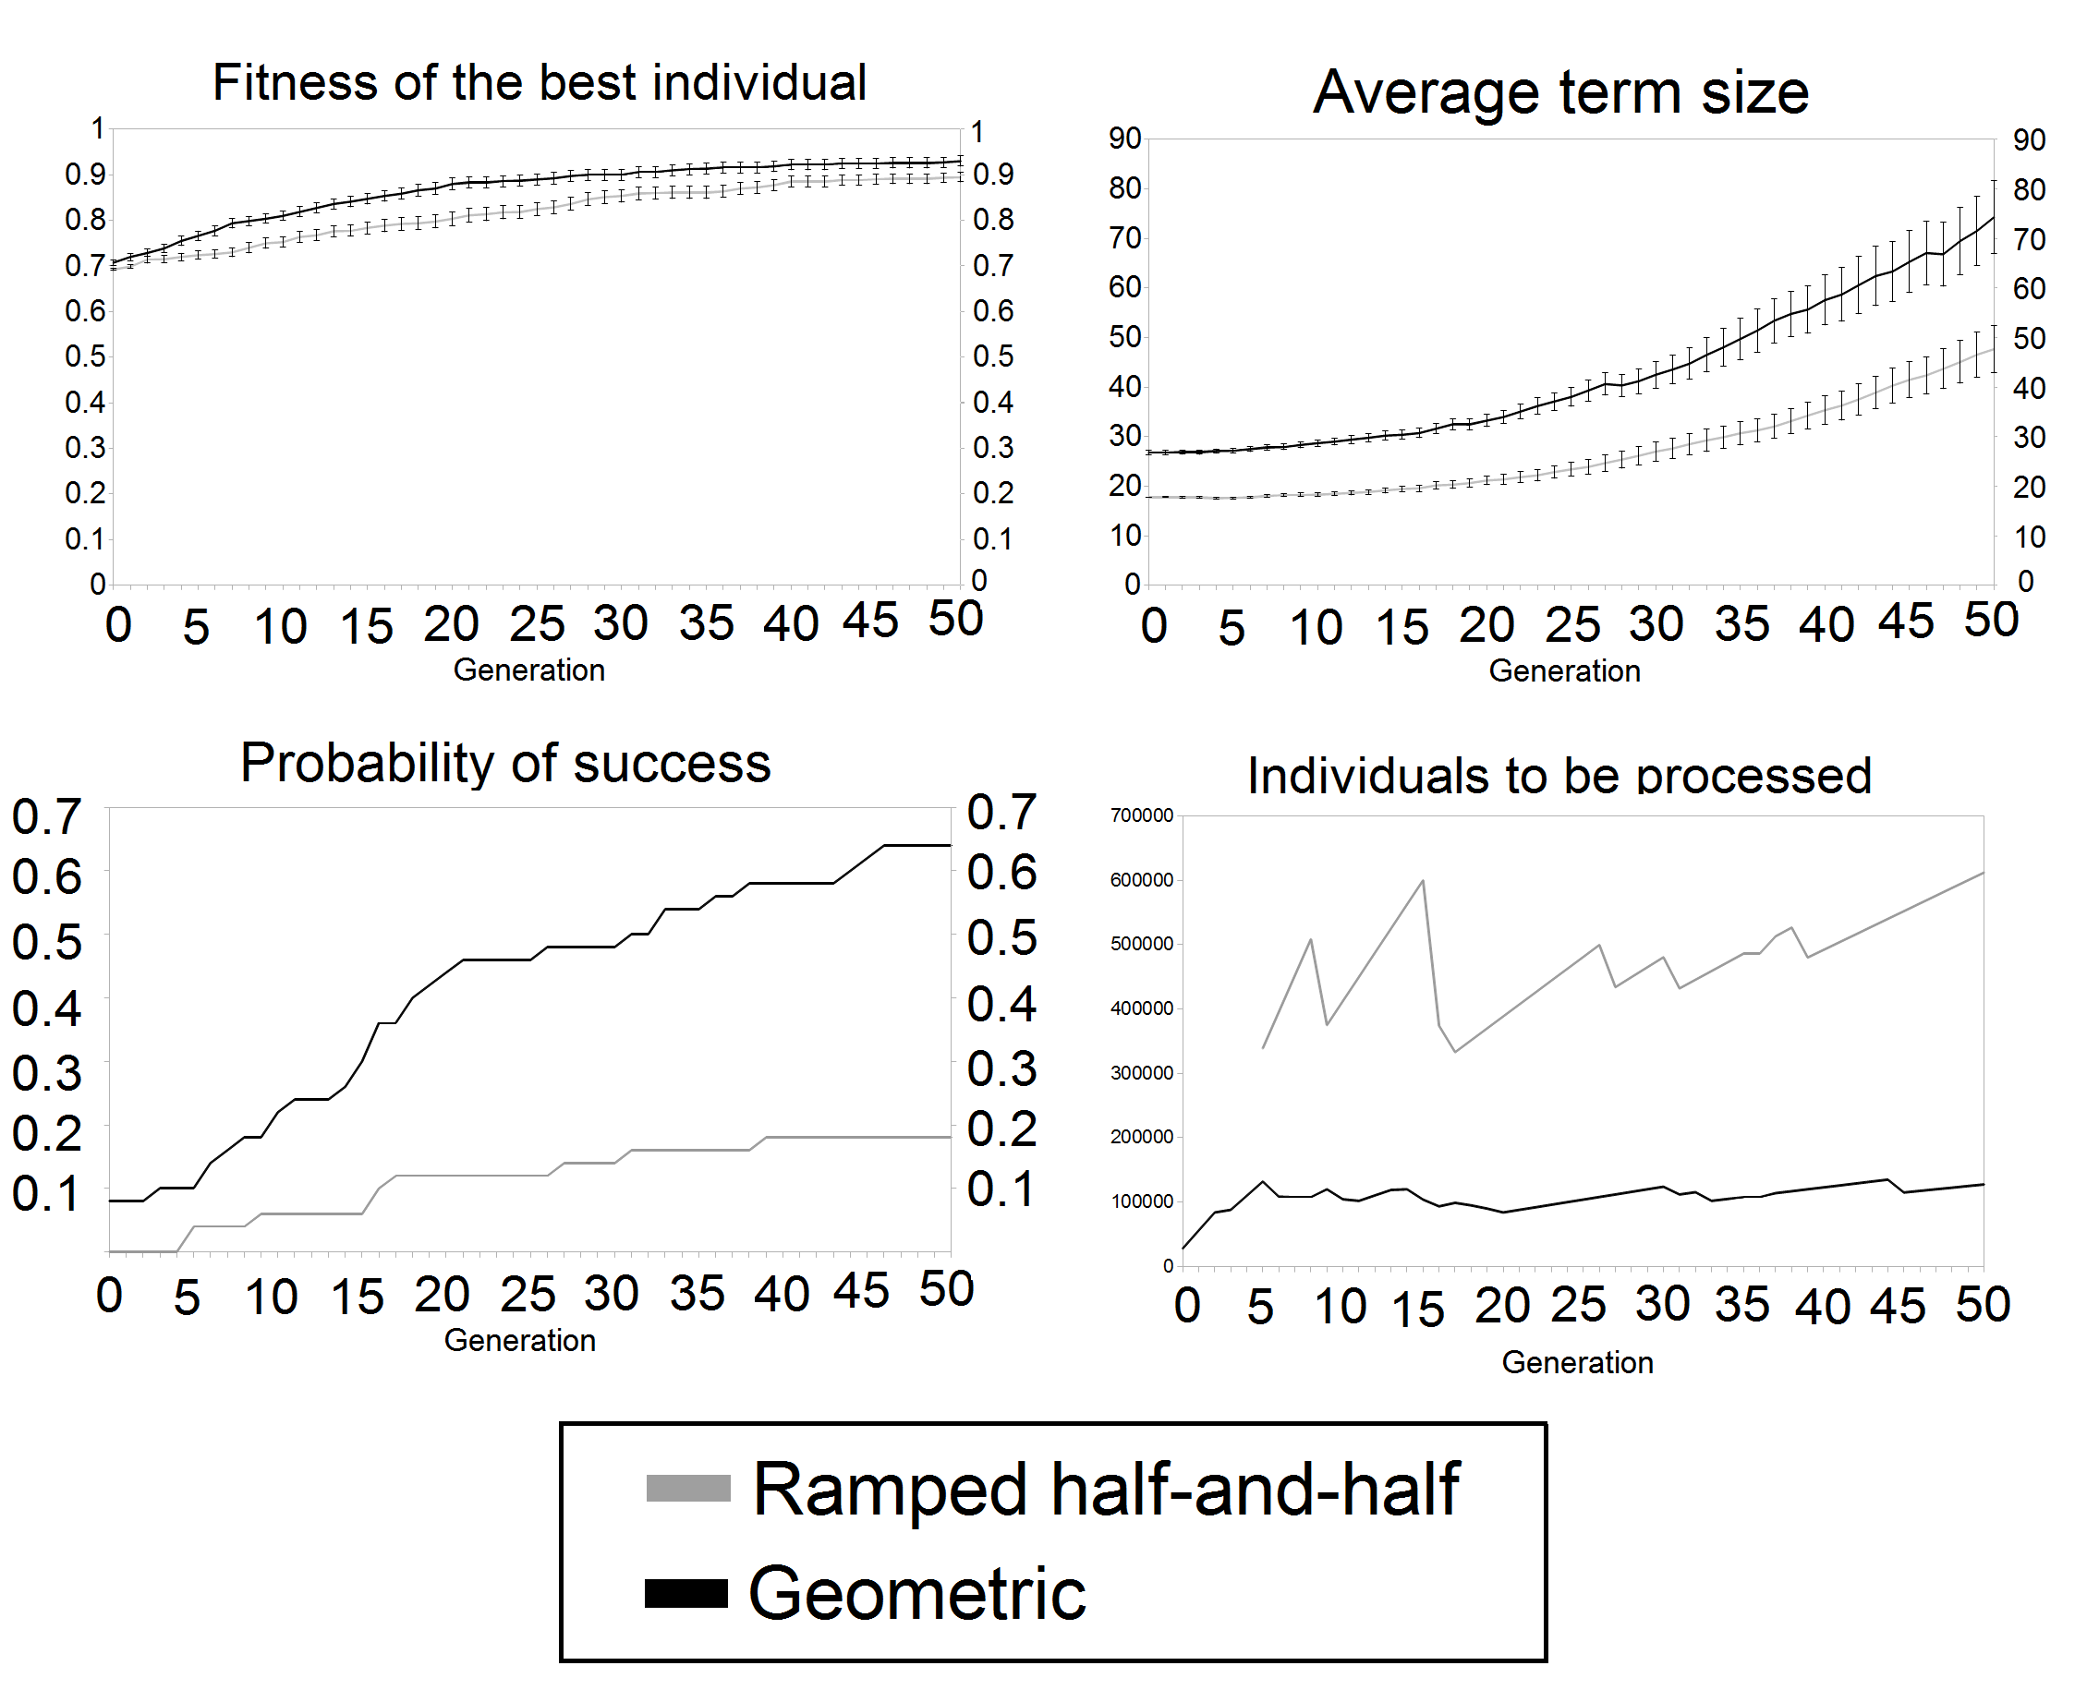
Even parity problem
Times: 28 minutes
33 minutes

Slide 23
Conclusions
Geometric outperforms standard Ramped half-and-half
It seems that it reduces bloat.
Works nicely with types.
Future work
  More test problems
  Stronger type systems
  Meta-evolution of generating strategy

Slide 24
Thank you for your attention!
Any questions?
tomkren@gmail.com
roman@cs.cas.cz

Slide 25
Generalization for simply typed lambda calculus
Dvě vety co je to LC
Hlavní věc co s LC přichází jsou anonymní funkce, které zavádějí lokální proměnné
Použití LC umožňuje pouzití stavebních symbolů se higher-order typy
Unfinished leaf navíc obsahuje lokální context, rozšířený o lokální proměnné
Dva obrázky
  Expand šipkového typu
  Expand nešipkového typu

Slide 26
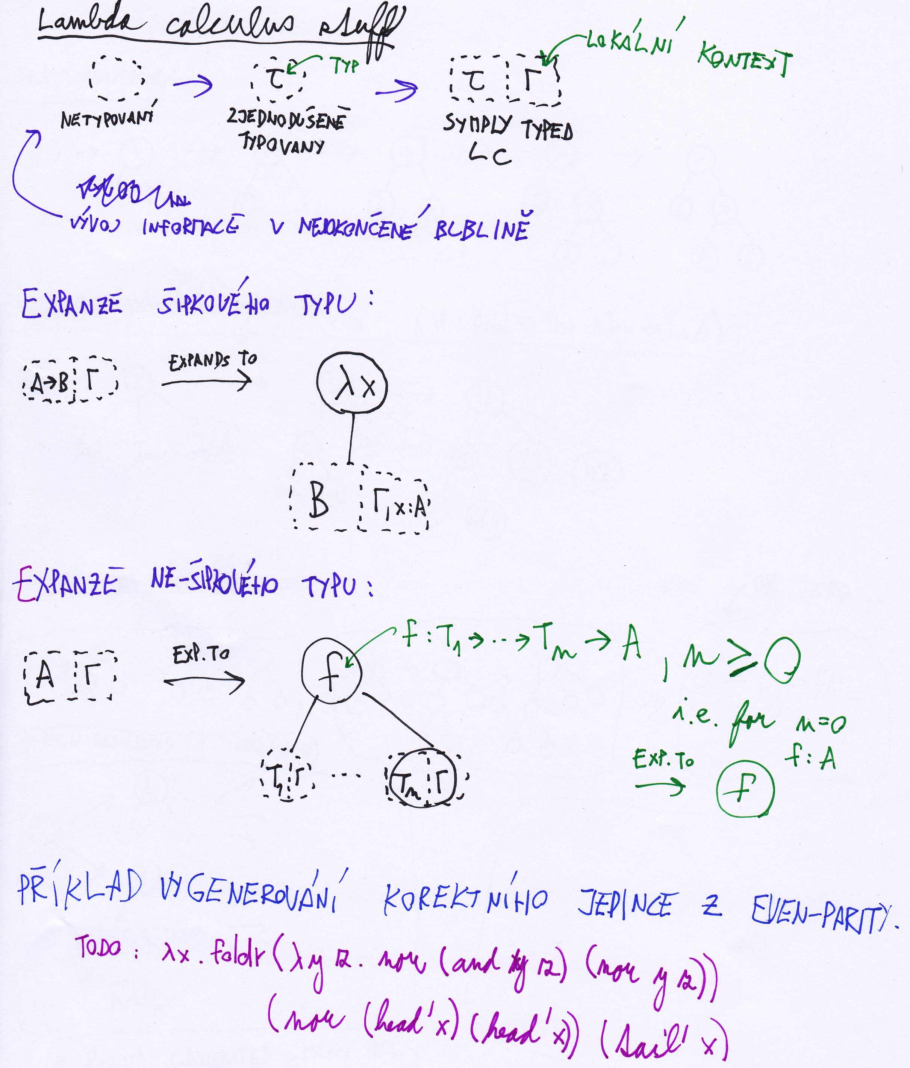

Slide 27
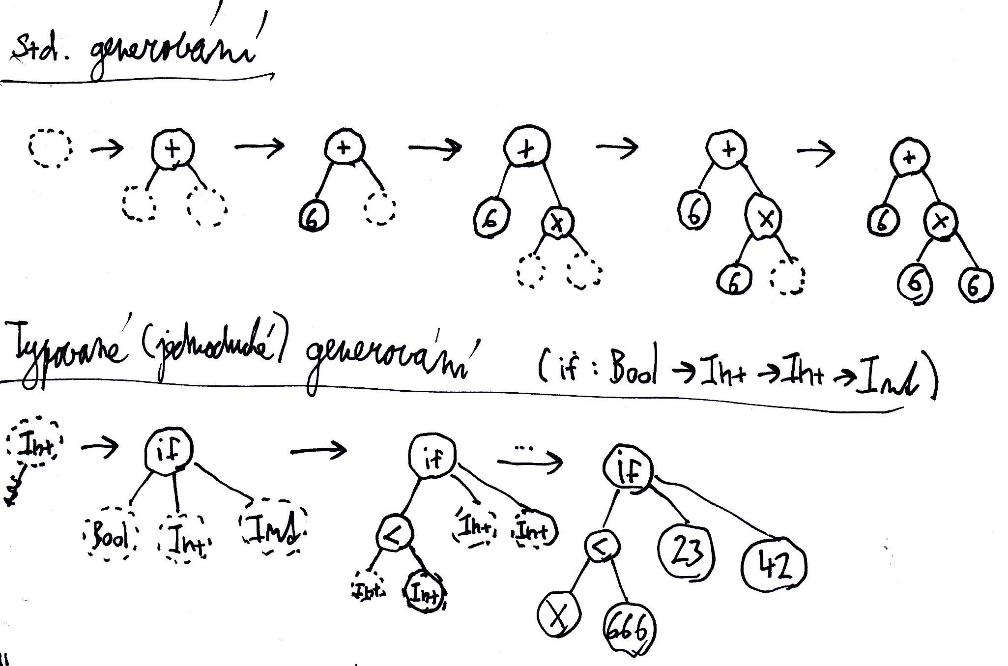
“One after another..”

Slide 28
Úvodní propaganda
Vzít z článku pár motivačních vět...

Slide 29
Standardní generování stromů v GP
Obrázek jak se to generuje do hloubky
A obrázek jak se to dělá, když je to typovaný (bez higher-orderismů, tzn argument nebude funkčního typu)
  do „unifinshed bubble“ se přidá info o typu, kterej pak musí volba stavebního symbolu akceptovat

Slide 30
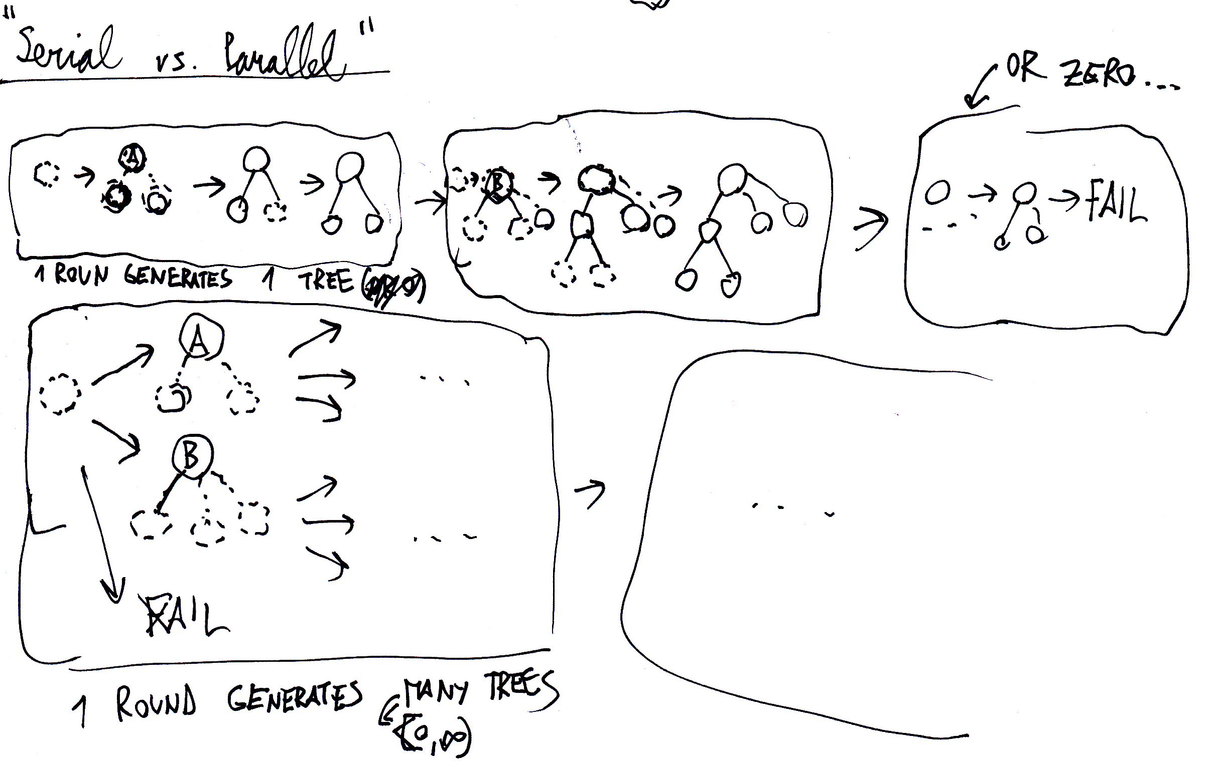
Sériově vs. paralelně
Std metoda dělá stromy sériově, má 1 rozpracovaný ten dodělá a začne další
  To dělá i ramped half-and-half
Stromy můžeme dělat i paralelně – tzn mít jich rozpracovaných víc

Slide 31
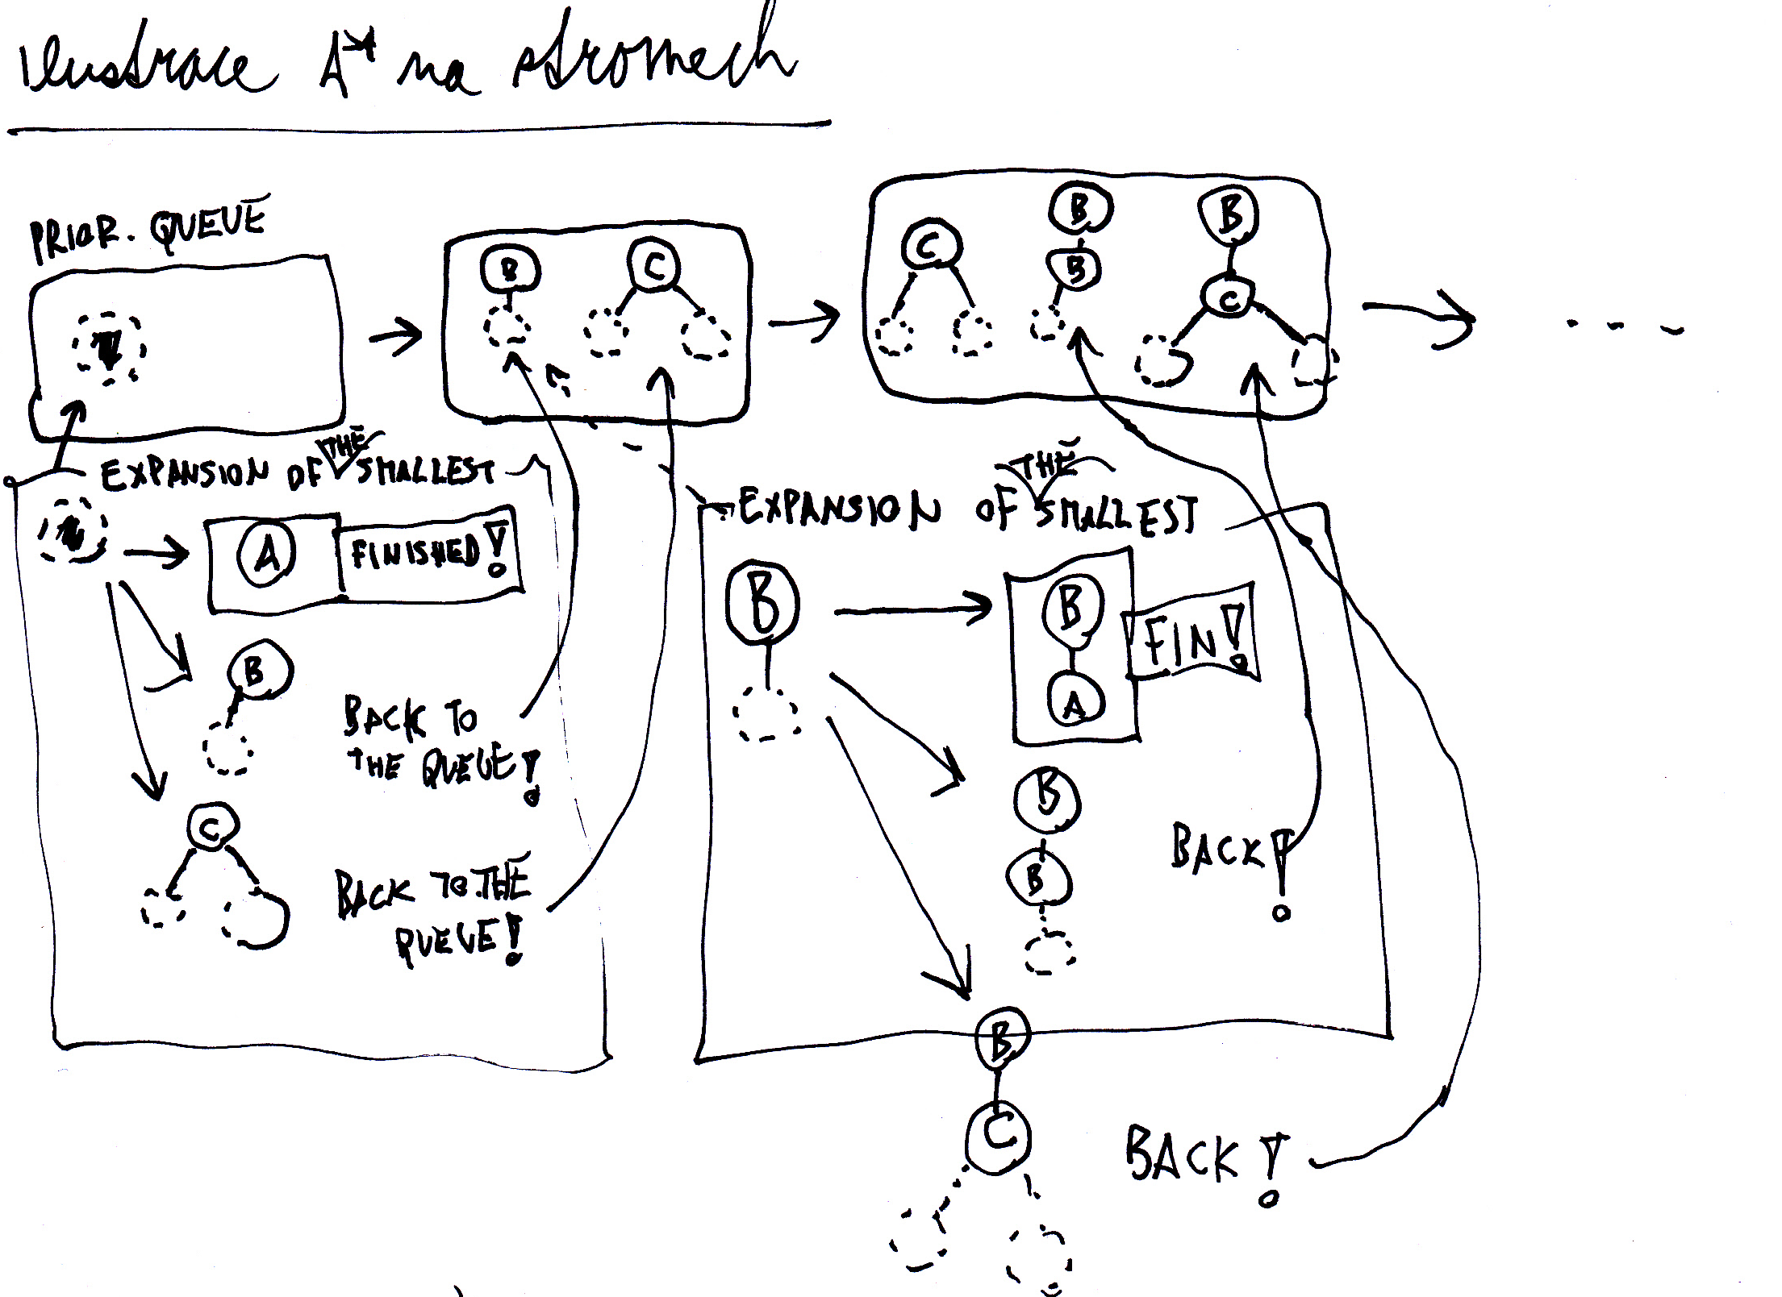

Slide 32


